Slide 1
Bedrock x Crescer AI
January• 2026

Slide 2
Agenda
Problem Formulation
Solution Approach
Demo
Results & Discussion
Next Steps

Slide 3
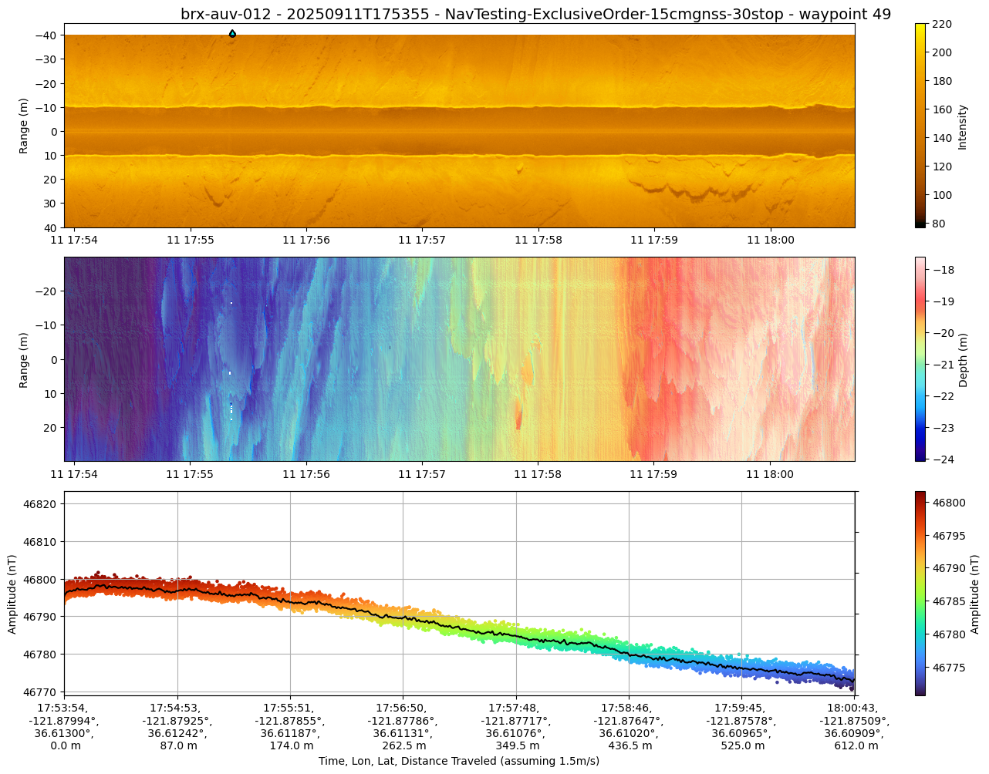
Automated SSS Target Detection (Internal proposal)
Goal
Onboard model that auto-detects discrete objects on sidescan per swath in waterfall mode
Re-run in ODA after nav post-processing, optional batch on processed data in Mollusk
Scope (v1)
Classes: contacts, pipelines, wrecks (extensible)
Outputs: Lat, Lon, Class (eventually confidence, size/orientation)
Hooks into: OBR annotation, optional acomms summary, option for retask signal to AUV nav stack
Why now
Faster preliminary contact lists
Consistent QC across sites, less analyst scroll time
Stronger sales posture; OSW, O&G, and Defense use cases (debris, UXO, cable exposure and scour)

Slide 4
R&D Project
BRX Leadership approved 3 month project with CrescerAI working with Bridgit/Jess on the following milestones:
Milestone 1: Delivery of a functional sample inference container that runs in CrescerAI’s environment and can be jointly deployed or debugged on Bedrock’s Jetson TX2 hardware, subject to Bedrock confirmation that such deliverable meets the agreed documentation and functionality requirements.
Milestone 2 : Presentation of an interim model that demonstrates detection capability on Bedrock-provided SSS data and includes an update on training progress and preliminary metrics report.
Milestone 3: Delivery of the final POC model, prototype Streamlit app, and full metrics report, followed by a joint smoke test on Bedrock’s Jetson TX2.

Slide 5

Data
Bedrock to provide Side Scan Sonar data with annotated survey and contact information and high value target classifications
Crescer to conduct EDA, partition, augment with existing and synthetic data as needed

Slide 6
Data
Training
Bedrock to provide Side Scan Sonar data with annotated survey and contact information and high value target classifications
Crescer to conduct EDA, partition, augment with existing and synthetic data as needed
Crescer to train Lumen object detection models on curated datasets
Optimize for lightweight onboard deployment

Slide 7
Data
Training
Evaluation
Bedrock to provide Side Scan Sonar data with annotated survey and contact information and high value target classifications
Crescer to conduct EDA, partition, augment with existing and synthetic data as needed
Crescer to train Lumen object detection models on curated datasets
Optimize for lightweight onboard deployment
Additional ablation testing to optimize model performance
Establish metrics on held-out data
Identify areas of improvement with additional (real or synthetic) data
Demo to stakeholders with defined integration and deployment pathway

Slide 8

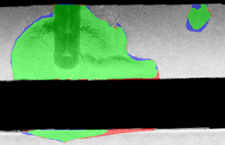
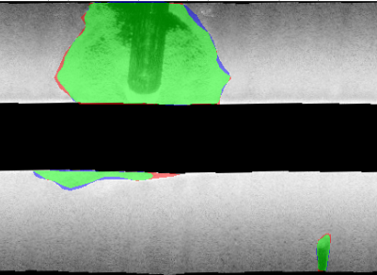
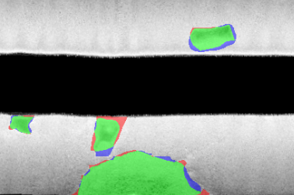
Detect targets in 3 min swath in <1 sec (Jetson Nano)
TP
FP
FN
Test yourselves!
Run the app here: http://brx-model-viewer.crescer.ai/

Slide 9
Good Metrics → Future tuning tradeoffs
Model Tuning | TP | FN | Recall | Precision | F1 Score
Baseline | 212 | 41 | 0.84 | 0.59 | 0.69
Augmentations | 215 | 38 | 0.85 | 0.53 | 0.65
Small Object Filtering | 203 | 50 | 0.80 | 0.67 | 0.73
Model

Slide 10
Good Metrics → Future tuning tradeoffs
Model Tuning | TP | FN | Recall | Precision | F1 Score
Baseline | 212 | 41 | 0.84 | 0.59 | 0.69
Augmentations | 215 | 38 | 0.85 | 0.53 | 0.65
Small Object Filtering | 203 | 50 | 0.80 | 0.67 | 0.73
Model
Inference Time | 0.917 sec | Avg per XTF
CPU % | 37% | Peak
GPU % | 99% | Peak
Memory Usage | 3.7 GB RAM + 2GB Swap | Peak @ batch=4 (linear scaling) upper limit on Jetson Nano
Performed on Jetson Nano
Expected to be better on TX2
Runtime

Slide 11
Model Size: More params -> More Bang for the Buck
Metrics | Lumen 10 | Lumen 20 | Lumen 25
Pixelwise F1 | 0.868 | 0.868 | 0.872
IoU | 0.767 | 0.768 | 0.773
Avg sec per processed XTF (TensorRT) | 0.565 | 0.680 | 0.917
Avg / Max CPU Utilization % | 11.1 / 37 | 10.1 / 37 | 10.1 / 37
Avg / Max GPU Utilization % | 81.7 / 99 | 85.4 / 99 | 87.0 / 99
All Models:
Good Metrics
Runs <1 sec
Reasonable CPU
Larger models → better performance, minimal extra cost.

Slide 12
Q4 2025
Streamlit Proof of Concept
Review and understand datasets that Bedrock has. Come up with a reasonable splitting strategy. Demo streamlit app on held out data.

Slide 13

Q4 2025
Streamlit Proof of Concept
Review and understand datasets that Bedrock has. Come up with a reasonable splitting strategy. Demo streamlit app on held out data.

Slide 14
Next Steps: Bring ATR to AUVs
Pipeline on Platform Demo
Further model improvements. TensorRT pipeline running on compute platform. Simulate onboard operation.
Pipeline on Vehicle Demo
End-to-end demo on Bedrock hardware
Deployment
Deploy on Bedrock AUVs for online testing and integration
Q4 2025
Q1 2026
Q2 2026
Q3 2026
Streamlit Proof of Concept
Review and understand datasets that Bedrock has. Come up with a reasonable splitting strategy. Demo streamlit app on held out data.

Slide 15
Next Steps: Bring ATR to AUVs
Pipeline on Platform Demo
Further model improvements. TensorRT pipeline running on compute platform. Simulate onboard operation.
Pipeline on Vehicle Demo
End-to-end demo on Bedrock hardware
Deployment
Deploy on Bedrock AUVs for online testing and integration
Q4 2025
Q1 2026
Q2 2026
Q3 2026
Streamlit Proof of Concept
Review and understand datasets that Bedrock has. Come up with a reasonable splitting strategy. Demo streamlit app on held out data.
Continued Partnership:
→ BRX to be only AUV company with onboard ATR
→ Target onboard POC for REPMUS

Slide 16
Appendix
January• 2026

Slide 17
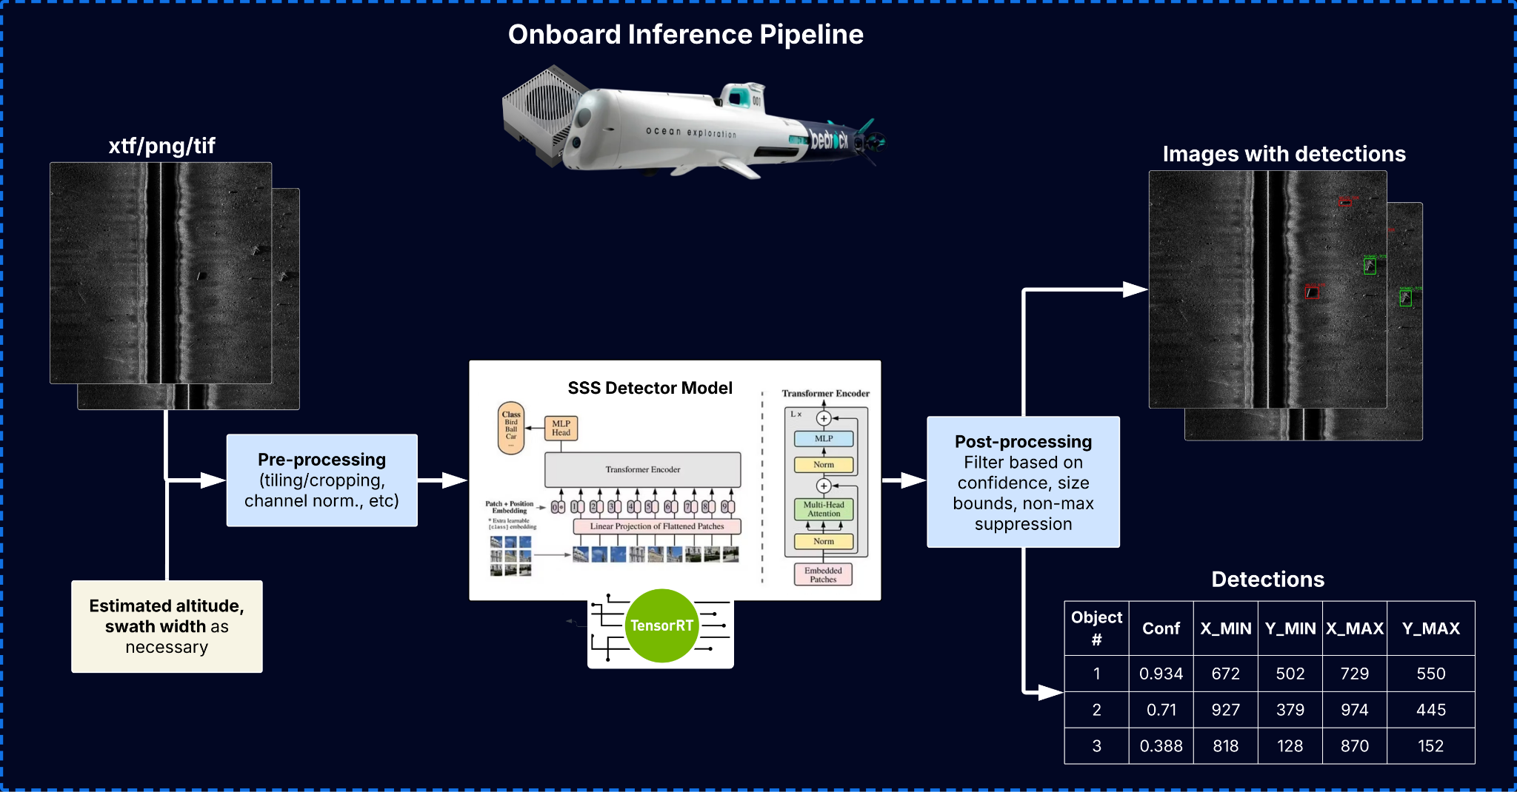
3 min swath processed in < 1 sec on a Jetson Nano
Great recall (>80%) → gets better with more data
Notes:
Good news, using our lumen architecture, we can process 3-min swaths in a second, puts you on track for onboard ATC

Slide 18
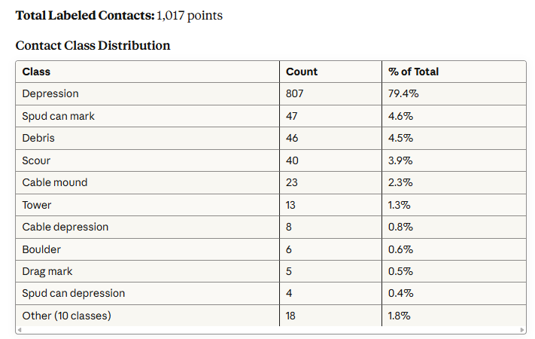
Dataset Overview
Dataset Composition
Total Raw Files: ~400 XTF files (side-scan sonar images)
Estimated Split (80/10/10):
Training: ~320 images
Validation: ~40 images
Testing: ~40 images
Estimated Coverage:
~80 images (~20%) contain labeled contact points
~320 images (~80%) represent background/negative examples
Key Notes
Class Imbalance: Depression contacts dominate the dataset (79%), presenting potential modeling challenges for minority classes
Data Quality: Metrics derived from processed SSS contact CSVs and visible polygon areas in shapefiles/mosaics

Slide 19
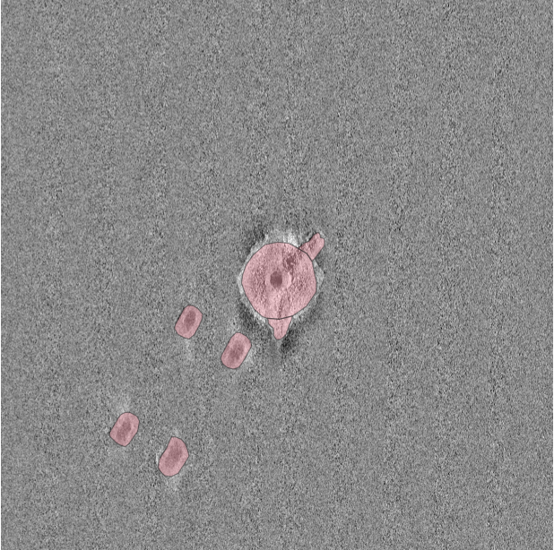
EDA - Well Defined Contacts

Slide 20
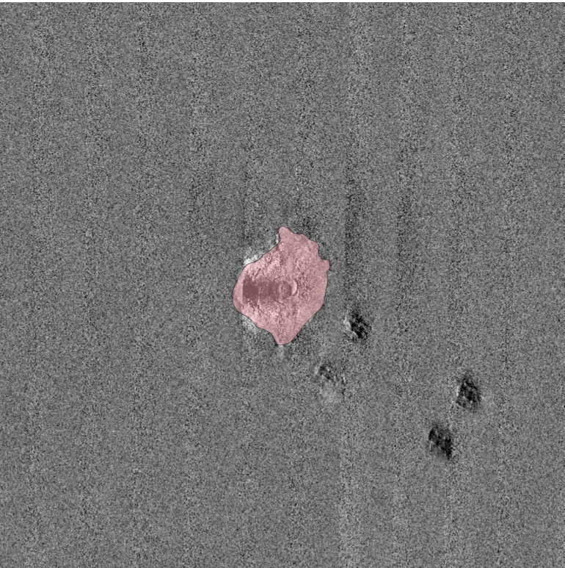
EDA - Missing Contacts

Slide 21
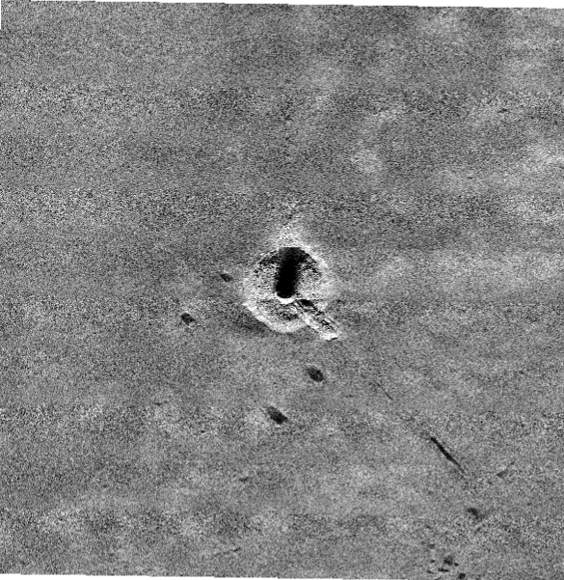
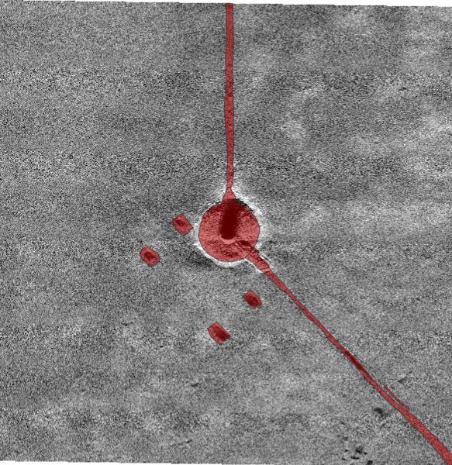
EDA - Invisible Contacts
Some contacts may not be able to be identified using SSS alone (seen in MBES and/or Mag data)

Slide 22

Annotated target is invisible in SSS image
RAW XTF
Bedrock GT
Proposed Addition
Proposed Removal
Red region not visible in SSS
File: Phase2_AP38_brx-auv-010-sss-20250617T162147Z
Diff Overlay XTF

Slide 23
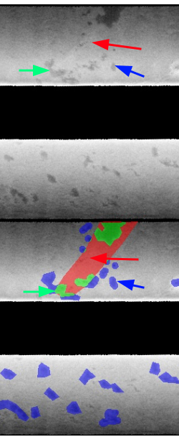
Visually similar features are not labelled
Bedrock GT
Proposed Addition
Proposed Removal
Red arrow is not visible in SSS.
Green arrow (BRX contact) looks visually similar to blue arrow
File: Phase1_AL38_brx-auv-006-sss-20250324T011120Z
-auv-006-sss-20250324T0
RAW XTF
Diff Overlay XTF

Slide 24


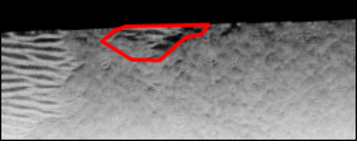
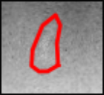

Areas of Improvements:
Low Contrast + Sand Ripples
False Negatives (Missing Targets)
False Positives (Erroneous detections)
Phase3_AN38_brx-auv-010-sss-20250828T163640Z
Phase2_AT40_brx-auv-010-sss-20250615T160811Z
Phase2_AT40_brx-auv-010-sss-20250615T123159Z

